Slide 1
Njål Andersen presents:
Calibrate your confidence in research findings:
A tutorial on improving research methods and practices
Aline da Silva Frost and Alison Ledgerwood (2020)
“…for the average researcher, it can be daunting to approach this new wealth of resources for the first time. You know that you want to understand the contours of recent developments and to learn as much as possible from the research you do, but where do you even begin? We think that one of the most important methodological skills to develop is how to calibrate your confidence in a finding to the actual strength of that finding.”
Notes:
Having too much
confidence in a finding can lead you to waste resources chasing and trying to build on an effect
that turns out to have been a false positive, thereby missing opportunities to discover other true
effects. Likewise, having too little confidence in a finding can lead you to miss opportunities to
build on solid and potentially important effects. Thus, in order to maximize what we learn from
the work that we do as scientists, we want to have a good sense of how much we learn from a
given finding.

Slide 2
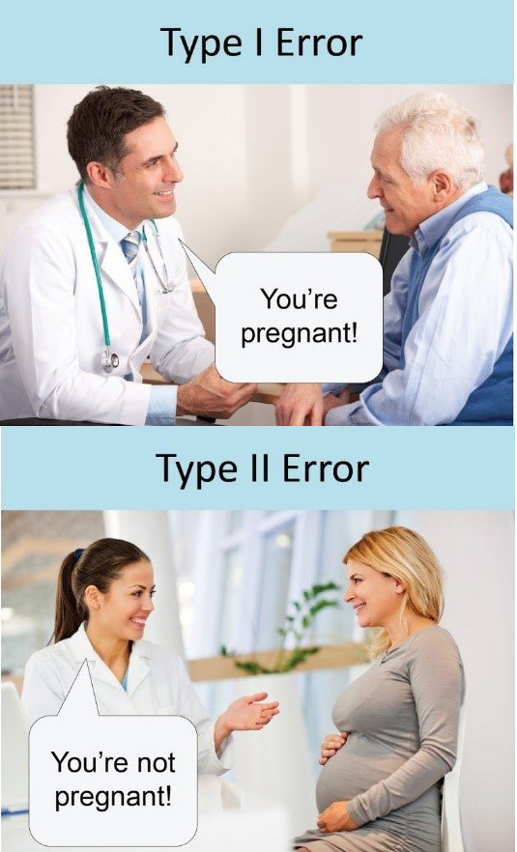
Structure of paper
Two parts:
  Strategies for assessing statistical power
    How to calculate them
    Estimate effect size
    Power for detecting interactions
  Strategies for assessing likelihood of Type 1 Error in a study
    Distinguish between confirmatory and exploratory
Notes:
Arguably, one of the central problems giving rise
to the field’s so-called “replicability crisis” is that researchers have not been especially skilled at
assessing either the statistical power or the Type I error rate of a given study – leading them to be
overly confident in the evidential value and replicability of significant results

Slide 3
Why these two: an illustration
Notes:
You have 20 ideas, and conduct 20 studies to teste them. How many will you identify as significant, and how many as non-significant.
(the optimal here, is to have all the T’s in the “significant!” and all the F’s in the nonsignificant. That is a dream world. :D
Where each end up after our studies, depend (At least in part) on POWER, and on our Alpha rates, (p-values)

Slide 4
Statistical power and Type I error determine the distribution
Notes:
With a power of 40%, only four out of the 10 true effects are found.
BUT, also, of all significant effects identified, only 4/7, or about 57% are true!
So of all the significant results you find, you can be proud, happy and content knowing that it is a little better than a coin flip as to whether they are true.
This is of course, NOT GOOD!

Slide 5
What if we increase power to 90%? What changes?
Notes:
Please, lets make this interactive. Take a guess!

Slide 6
Statistical power and Type I error determine the distribution
Notes:
You identify 9 out of 10 true effects. This is very good! BUT, it does not change the Type 1 error rate!
So yes, MUCH better with now 9/12 chance of your significant results being true (75%).. But this shows that we both need to think about power, AND about Type 1 error rates.

Slide 7
Part 1: build your power intuition
Some benchmarks / rules of thumb:
For a two condition, between subject study:
  Large effect (Cohen’s D = .80): N=50
  Medium effect (Cohen’s D = .50): N=130
  Small effect (Cohen’s D = .20): N=800
To test interactions, need much larger sample sizes!
(the example here is for the Medium effect above)
  Cross-over interaction effect: N*2 → 260
  Knockout interaction effect: N*4 → 520
  50% attenuation interaction effect: N*14 → 1820
For “small effects”, the numbers are:
  N=1 600; N=3 200 and N=11 200
Notes:
a perfect cross-over interaction (i.e., you think the effect you saw in Study 1 will appear in one condition of Factor B and reverse completely in the other), eg. Affect people in opposite ways.
knockout interaction (i.e., you think the effect you saw in Study 1 will appear in one condition of Factor B and disappear in the other) eg. Only be there for Women
And if you expect a 50% attenuation (i.e., you think the effect you saw in Study 1 will appear in one condition of Factor B and be reduced to half its original size in the other),
so, effect for women remain constant, but the effect is only half for men..
All to say: interaction effects for small effects,.. You need A LOT of respondents!
So what sort of effects are we examining? Large? Medium? Small?

Slide 8
Part 1: build your power intuition
What do we mean by “effect”?
  Large effect (Cohen’s D = .80): N=50
    “an effect that even a casual observer would notice (e.g., the correlation between relationships satisfaction and breakup”
  Medium effect (Cohen’s D = .50): N=130
    “represent an effect likely to be visible to the naked eye of a careful observer” (p. 156), so a medium-sized effect is one that we might observe simply by watching people closely.”
  Small effect (Cohen’s D = .20): N=800
    “typically too small to be seen with the naked eye (e.g., if you’re interested in testing a counterintuitive prediction that would be surprising to most people, it is likely to be a small effect if it is true).”

Slide 9
When designing your own study...
A priori power analysis to identify how many participants for your study
  Decide your power level (eg 80%)
  Your statistical test (t-test: comparing two between-subject conditions?)
  Estimated effect size.. Eg d=.40 for a smallish medium sized effect.
How do you figure out your estimated effect size?
  Challenges:
    They fluctuate between studies, esp. for small sample sizes
    Publication bias tends to inflate effect size
    → they tend to be exaggerated in the literature.

Slide 10
When designing your own study...
How do you figure out your estimated effect size?
  Solutions:
    Focus on studies with bit samples, that what to show size of effect, not existence of effect
    Use meta analysis if possible
      Preferably those who correct for publication bias!
Use a priori power calculators, eg:
  G*Power, PANGEA, pwrSEM.
If no good estimates for effect size? Use a program that accounts for uncertainty:
  https://designingexperiments.com/shiny-r-web-apps

Slide 11
Nothing to base effect size estimate on?
Identify the smallest effect size of interest (SESOI)
  How big should the effect size be for you to care about it? If it should be detectable by trained experts, a medium effect: d=0.50.
  State this clearly, and then risk having to reject if smaller.
    This can stop you from reporting on the direction of the effect...
“Biggest Sample Size Worth Collecting” (BSSWC).
  Decide how much resources you are willing to spend to examine the question.
    Eg. Two group experiment, N=100?
      You have then decided you only care about D=0.56.
(These two are of course equivalent, but a different way of thinking about it).

Slide 12
How to conserve resources
Conduct sequential analysis.
  Set your max sample size
  Set middle points, that tell you to stop collecting data. These MUST be set ahead of data analysis (otherwise you inflate your Type 1 Error rate)
  Each check reduces your power, a little bit.
Notes:
IF you get below 0.025 after 300, you can stop collecting data, as you have significant results. Saving 300 participants.
See the paper for how to set up these stops, and for links to an example of how to write it up)

Slide 13
Alternative to increasing N: Boost your power
Boost power by:
  Do a within-subject rather than between subject test
  Strengthen the manipulation
  Improve reliability of your measure
  A priori select a covariate that correlates strongly with measure of interest
  Try to join in a large scale collaboration project on it, and aggregate results.
Notes:
Some populations are hard to reach, or costly. Then, boost your power!

Slide 14
When you already have the data…
Sensitivity analysis
  Put in sample size, test, and power, and a program calculates the effect size you can detect with the data.
  Tells us what we can expect from the analysis.
→ we can use this to calibrate our confidence in the statistical results.

Slide 15
Post-hock analysis
It is possible to conduct “post hoc power analysis” or “observed power”.
  Using the observed power in these analysis gives the illusion of precise information about a study, but actually only gives a piece of imprecise information that is already known, given the p value of the study.
In short: don’t do it.

Slide 16
Part II
Type I error rate

Slide 17
Type I Error rates
Error rate set by the alpha cut-off against which P-value.
  Typically P<.05; P<.01; P<.001
Can be inflated by other factors, esp. data-dependent decisions (amount of increase is often unknown)
  Decision to collect more data based on significance
    Multiple rounds and it increases significantly
  Running analysis with and without various co-variates, until one finds significance
  Testing an effect with three slightly different dependent variables, and only reporting significant
    “In fact, even the common practice of conducting a 2 × 2 factorial ANOVA and reporting all effects (two main effects and an interaction) has an associated type I error rate of about 14% rather than the 5% researchers typically assume”

Slide 18
“Data-dependent analyses are often extremely useful
… but we want to know that an analysis is data-dependent so we can calibrate our confidence in the results accordingly”
This is often the case when you know your data.
  Eg. In political science, studying election outcomes.
Solution: Create a preanalysis plan
  Write down all researcher decisions before you analyze the data.
  Circumvent human biases in thinking and memory
  “After looking at the data, it is very easy to convince ourselves we actually intended to do these particular tests and make these particular decisions all along. By creating a record of which decisions were in fact data-independent, preanalysis plans allow researchers to distinguish between data dependent and data-independent analyses.”
Notes:
For example, if you write down ahead of time that you will include a carefully chosen covariate in your analysis and you follow that plan, you can rest assured that you have not unintentionally inflated your type I error rate
On the other hand, if you decide after
looking at the data to include a different covariate or none at
all, you can calibrate your confidence in that data-dependent
analysis accordingly (e.g., being more tentative about that result
until someone can test if it replicates).

Slide 19
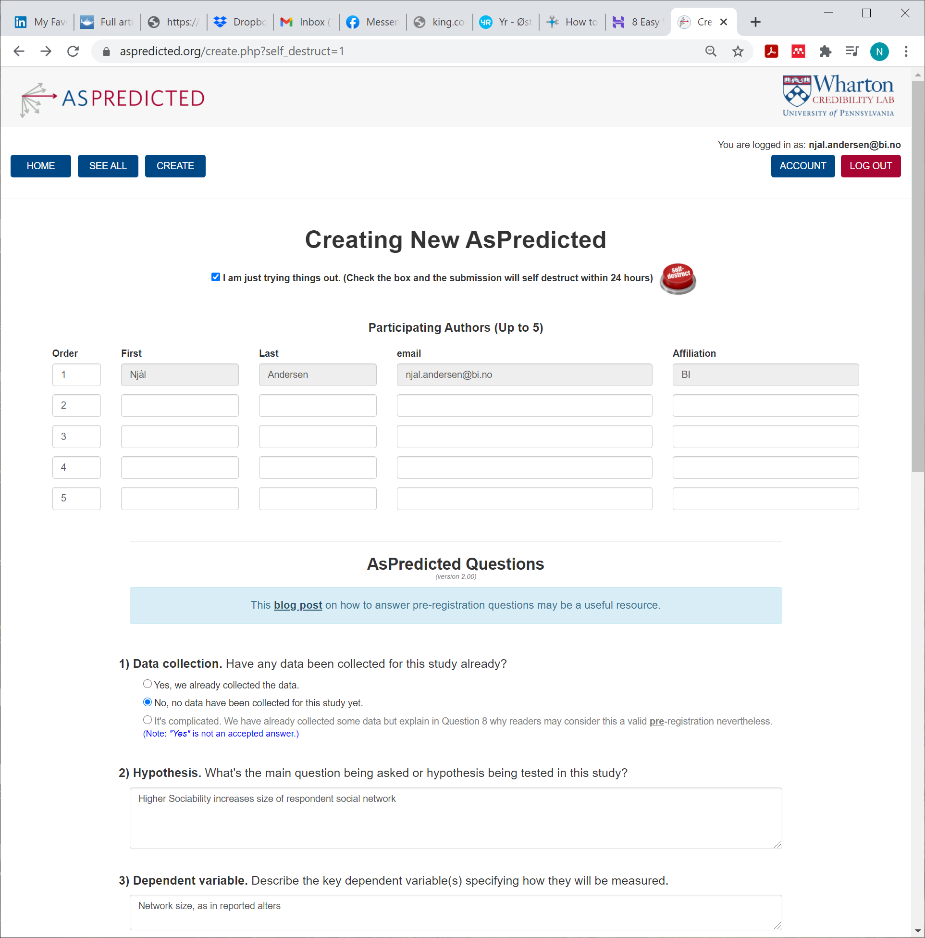
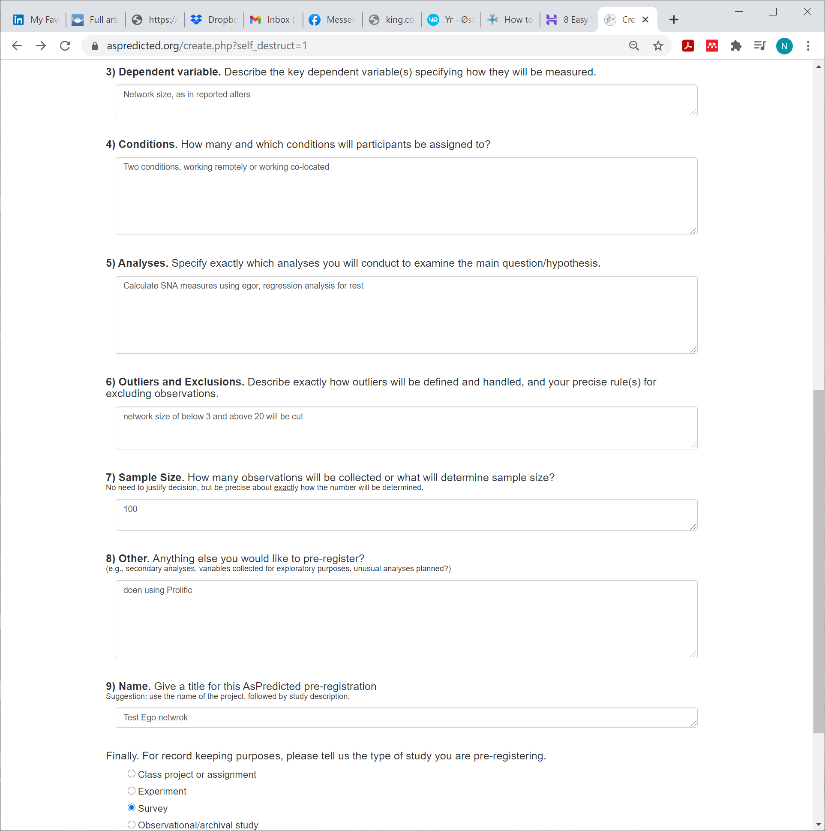
There are tools to help you make it
see also: https://osf.io/zab38/ for PLENTY of templates
Notes:
Here the plan is recorded, and you can refer to it if you choose to.

Slide 20
Type I Error rates
Other sources of inflation:
  Multiple comparisons
  Inappropriate statistical tests
  Violated statistical assumptions

Slide 21
Preregistration… what’s in a name?
- There are different types of preregistration
Definition | Goal
Preanalysis plan | Distinguish data-independent vs. data-dependent analyses; constraining unintended type I error inflation
Write down as much information as you can about your study before you conduct it | Transparency: Someone else can check what you said you planned ahead of time against what you actually wrote down
Record your theoretical predictions | Theory falsification
Record your intuitive predictions | Figure out how good you are personally at guessing a study’s outcome
Record the existence of your study in a centralized, searchable repository | Combat publication bias
Registered report | All of the above plus reviewer objectivity (reviewers can evaluate the methods and planned analyses without being biased by the whether the results fit their intuitions or theories)
Notes:
Note: not all of these constrain Type 1 Errors. Which do? GUESS.
Well, in general, first, second and fifth does, IF done well.
Each has their own purpose, and costs. Think about each, and what they contribute with, and the costs.

Slide 22
Preregistration… what’s in a name?
- There are different types of preregistration
“Did the preregistration contain a careful and complete preanalysis
plan that fully constrained flexibility in dataset construction and
analysis decisions? Did the plan successfully account for multiple
comparisons? And did the researcher exactly follow the plan for all
analyses described as data-independent? Thinking carefully and
critically about preregistration will help you identify which of
the goals (if any) listed in Table 4 have been achieved by a given
study, and whether you should be more or less confident in that
study’s conclusions.”

Slide 23
Takeaways:
Helps identify what studies we should base our own research on
Helps plan studies → relieves a lot of stress down the road when conducting study
  Forces you to plan with care, that may result in a better study
This is as true for experiments, as other studies
….

